Slide 1
Web of Things (WoT) IG/WG
October 2020
Notes:
Script:
The goal of the Web of Things is to enhance IoT interoperability.

Slide 2
Goal and Use Cases
IoT Interoperability
Simplify usage
Interaction abstraction
Simplify data ingestion
Unified data schemas
Bridge silos
Protocol bindings
Enable "mashups"
Scripting API
Notes:
Script:
We want to simplify the usage of IoT devices.
We want to simplify the ingestion of data from IoT devices into various services.
We want to bridge silos, including connecting devices locally, converting data from different vendors, and bridging different protocols.
Ultimately we want to enable "mashups", where new services can be derived from existing services.

Slide 3
Current Work Items
Deliverables | Updates | New
Informative | Scripting API Security and Privacy Guidelines Best Practices | Use Cases
Normative | Architecture Thing Description Thing Models | Discovery Interoperability Profiles
Notes:
Script:
We are in our second charter.
Our current work items include updates to existing work describing the WoT Architecture.
It also includes updates to our Thing Description metadata format,
including support for instance-independent models for classes of things.
New work includes development of a detailed use case document and new normative work on discovery and profiles.

Slide 4

Thing Description
{
"@context": [
"https://www.w3.org/2019/wot/td/v1",
{ "iot": "http://iotschema.org/" }
],
"id": "urn:dev:org:32473:1234567890",
"title": "MyLEDThing",
"description": "RGB LED torchiere",
"@type": ["Thing", "iot:Light"],
"securityDefinitions": ["default": {
"scheme": "bearer"
}],
"security": ["default"],
"properties": {
"brightness": {
"@type": ["iot:Brightness"],
"type": "integer",
"minimum": 0,
"maximum": 100,
"forms": [ ... ]
}
},
"actions": {
"fadeIn": {
...
Metadata for IoT services
ID, versions, types, creation time, ...
Titles, descriptions, ...
Describes interactions
What they are (abstraction)
How to use them (protocol binding)
How to interpret data (schemas)
JSON-LD 1.1
Vocabulary extensions
Semantic annotation (e.g. OneDM)
Protocol-specific vocabulary
Notes:
Script:
The Thing Description is our major deliverable from our last charter, and we are currently updating it.
It is JSON-LD 1.1 document providing metadata describing IoT services.
It includes both general and human-readable metadata, the latter being provided to support user interfaces.
As a JSON-LD 1.1 document, it also supports semantics and integrates with efforts for semantic modelling of IoT services.
Thing descriptions also provide a description of the network interface of a Thing including security requirements, a set of interactions, data schemas for payloads, and bindings to concrete network protocols.

Slide 5
New Work Items
Use Cases:
Expanding catalog of use cases
Identifying requirements
Identifying gaps and overlaps
Edge computing
Geospatial systems
Data modeling
...
Discovery:
Define how TDs are distributed
Both local and global contexts
Spatial search not limited to local network
Two-phase introduction/exploration
Emphasis on privacy protection
Protected queries and exploration services
Architecture:
Lifecycle
Updated requirements analysis
Based on new use cases
Alignment with other standards
Interoperability Profiles:
Support interoperability
Out-of-the-box plug-and-play
Constrain features
Allow for finite, in-advance implementation of consumers
Notes:
Script:
New work items include an expanded and more detailed set of use cases, intended to identify gaps and overlaps.
Updates to the Architecture document include device and information lifecycles and updated requirements based on the use case analysis.
The Discovery deliverable defines a mechanism to deliver Thing Descriptions in a secure and privacy-preserving way,
while enabling content-based queries and spatial searches.
Finally, Interoperability Profiles support out-of-the-box plug-and-play by defining a finite subset of features that implementations may limit themselves to.

Slide 6
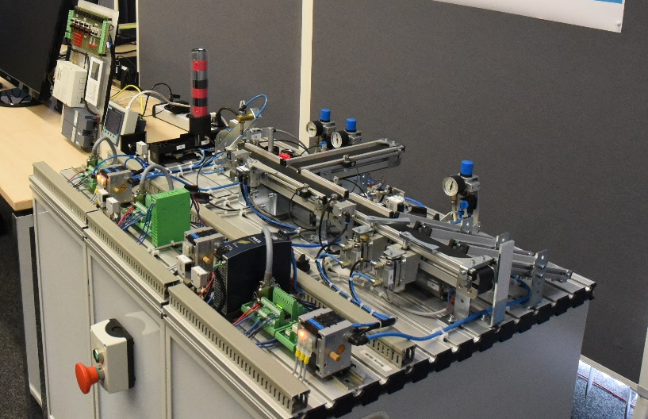
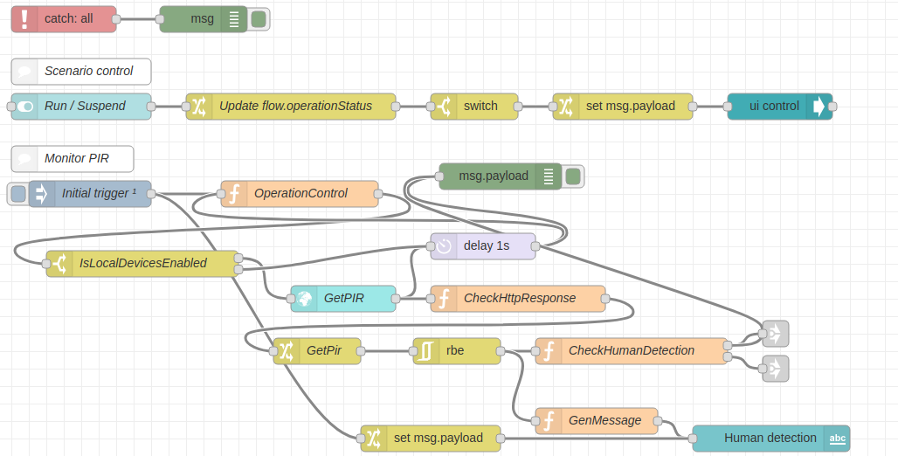
Other Activities
Implementations
Testing and Validation
Node-wot
Scripting API implementation
Node-gen
Node-RED integration
Playground
TD checker
Plugfests
Notes:
Script:
We are also working on various other projects, including implementations, testbeds, and tools.
We also have frequent plugfests where we attempt connecting implementations from different participants and validate interoperability.

Slide 7
W3C WoT Resources
W3C WoT Wiki
https://www.w3.org/WoT/IG/wiki (IG/WG organizational information)
W3C WoT Interest Group
https://www.w3.org/2016/07/wot-ig-charter.html (old charter)
https://www.w3.org/2019/10/wot-ig-2019.html (new charter)
https://lists.w3.org/Archives/Public/public-wot-ig/ (mailing list)
https://github.com/w3c/wot (technical proposals)
W3C WoT Working Group
https://www.w3.org/2016/12/wot-wg-2016.html (old charter)
https://www.w3.org/2020/01/wot-wg-charter.html (new charter)
https://www.w3.org/WoT/WG/ (dashboard)
W3C WoT Candidate Recommendations
https://www.w3.org/TR/wot-architecture/
https://www.w3.org/TR/wot-thing-description/
W3C WoT Working Drafts / Group Notes
https://www.w3.org/TR/wot-binding-templates/
https://www.w3.org/TR/wot-scripting-api/
https://www.w3.org/TR/wot-security/
W3C WoT Editors’ Drafts and Issue Tracker
https://github.com/w3c/wot-architecture/
https://github.com/w3c/wot-thing-description/
https://github.com/w3c/wot-binding-templates/
https://github.com/w3c/wot-scripting-api/
https://github.com/w3c/wot-security/
https://github.com/w3c/wot-security-best-practices/
https://github.com/w3c/wot-profile/
https://github.com/w3c/wot-discovery/
Reference Implementations and Tools: node-wot
node-wot: https://github.com/eclipse/thingweb.node-wot
TD playground: http://plugfest.thingweb.io/playground/
Notes:
Script:
For further information, we provide the following set of resources...

Slide 8
Contacts
https://www.w3.org/WoT/WG/
Dr. Michael McCool
Principal Engineer
Intel
Technology Pathfinding
michael.mccool@intel.com
Dr. Sebastian Kaebisch
Senior Key Expert
Siemens
Corporate Technology
sebastian.kaebisch@siemens.com
Notes:
Script:
... or you can contact the chairs.

Slide 9
Notes:
Script:
Thank you.

